Slide 1
Data Science Process Ch 1

Slide 2
Data Science Process Ch 1
Title Slide
What is Data Science?
Why Data Science Matters
Core Responsibilities of a Data Scientist
Business Example: German Bank Loan Case
Overview of Project Roles
Role: Project Sponsor
Role: Client
Role: Data Scientist
Roles: Data Architect and Operations

Slide 3
Data Science Process Ch 1
Lifecycle of a Data Science Project
Stage 1: Defining the Goal
Setting Measurable and Clear Objectives
Stage 2: Data Collection and Management
Dealing with Bias and Ensuring Data Quality
Stage 3: Data Cleaning and Exploration
Stage 4: Modeling Techniques
Decision Tree Example Walkthrough
Stage 5: Model Evaluation – Metrics and Confusion Matrix
Stage 6: Presenting Results to Stakeholders

Slide 4
Data Science Process Ch 1
Stage 7: Deployment and Real-World Testing
Challenges During Deployment
Setting Expectations and Defining Success
Summary of the Data Science Lifecycle

Slide 5
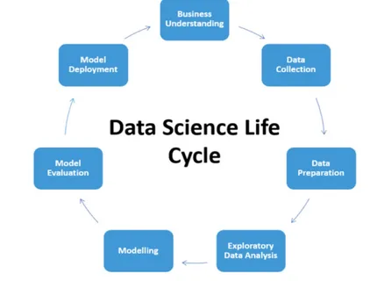
What is Data Science?
Cross-Disciplinary Practice: Combines methods from data engineering, statistics, data mining, and machine learning.
Data-Driven Decisions: Focuses on implementing data-driven decisions and managing their consequences.
Business and Scientific Problems: Applied to solve complex problems in various domains.
Generated on AIDOCMAKER.COM (Image Credit)

Slide 6
Why Data Science Matters
Quantifiable Goals: Ensures projects have clear, measurable objectives for success.
Good Methodology: Employs robust methods for reliable and repeatable results.
Cross-Discipline Collaboration: Facilitates effective teamwork across different expertise areas.

Slide 7
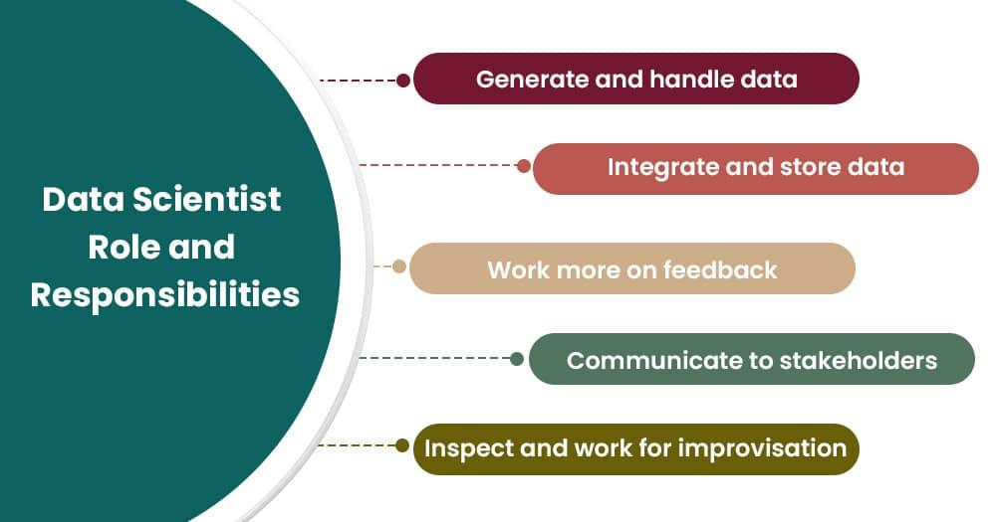
Core Responsibilities of a Data Scientist
Project Guidance: Responsible for guiding projects from initiation to completion.
Analytic Strategy: Sets and executes the analytic strategy for the project.
Communication: Communicates with sponsors and clients to ensure alignment.
Generated on AIDOCMAKER.COM (Image Credit)

Slide 8
Business Example: German Bank Loan Case
Problem: Loan Losses: Bank aims to reduce losses from bad loans.
Objective: Detect Risky Loans: Develop a tool to help loan officers accurately detect risky loans.
Data-Driven Solution: Utilize data science to improve loan risk assessment.

Slide 9
Overview of Project Roles
Collaborative Effort: Data science projects involve various specialized roles.
Key Contributors: Roles include sponsor, client, data scientist, architect, and operations.
Interdependent Functions: Each role contributes unique skills and responsibilities for project success.

Slide 10
Role: Project Sponsor
Represents Business Interests: Champions the project and defines business needs.
Defines Success: Determines if the project outcome meets business goals.
Key Decision Maker: Approves project goals and deliverables.

Slide 11
Role: Client
Represents End Users: Defines the interests of the model's end users.
Domain Expert: Provides expertise on business processes and context.
Interface for Deployment: Bridges the gap between model and day-to-day work.

Slide 12
Role: Data Scientist
Leads Project Execution: Manages project strategy, data, and tools.
Technical Expertise: Applies statistics, machine learning, and analysis techniques.
Problem Solver: Develops solutions by leveraging data insights.

Slide 13
Roles: Data Architect and Operations
Data Architect: Manages data and its storage; ensures data availability.
Operations: Handles infrastructure and final deployment of results.
Essential Support: Crucial for data acquisition and delivering final outputs.

Slide 14
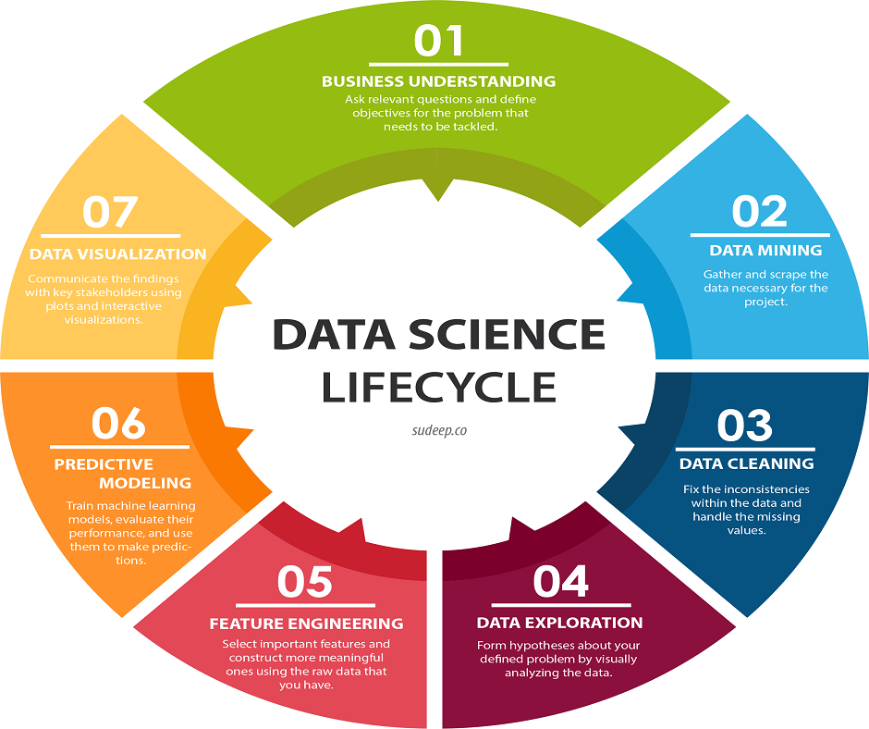
Lifecycle of a Data Science Project
Iterative Process: Stages overlap and often involve looping back to previous steps.
Continuous Feedback: Encourages feedback and iteration between data scientists and stakeholders.
Key Stages: Includes defining goals, collecting data, modeling, and evaluation.
Generated on AIDOCMAKER.COM (Image Credit)

Slide 15
Stage 1: Defining the Goal
Measurable Objectives: Define specific, quantifiable goals for the project.
Understand Context: Clarify why the project is needed and what it aims to achieve.
Resource Assessment: Determine necessary data, staff, and computational resources.

Slide 16
Setting Measurable and Clear Objectives
Specificity is Key: Vague goals lead to unbounded projects and dissatisfaction.
Quantitative Statements: Express goals as measurable targets (e.g., reduce charge-offs by 10%).
Define Stopping Conditions: Establish clear criteria for when the project is complete.

Slide 17
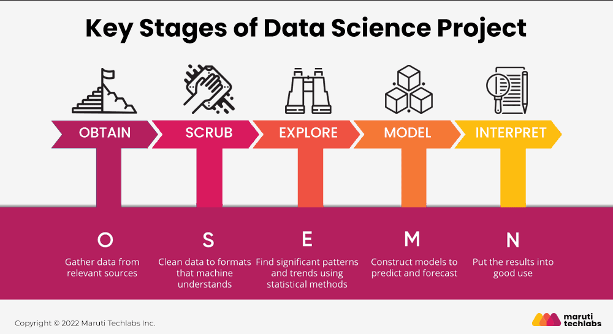
Stage 2: Data Collection and Management
Identify Data Needs: Determine what data is required to meet project goals.
Assess Data Suitability: Evaluate if the data is relevant, sufficient, and of good quality.
Time-Consuming Phase: Often the most intensive stage of the project.
Generated on AIDOCMAKER.COM (Image Credit)

Slide 18
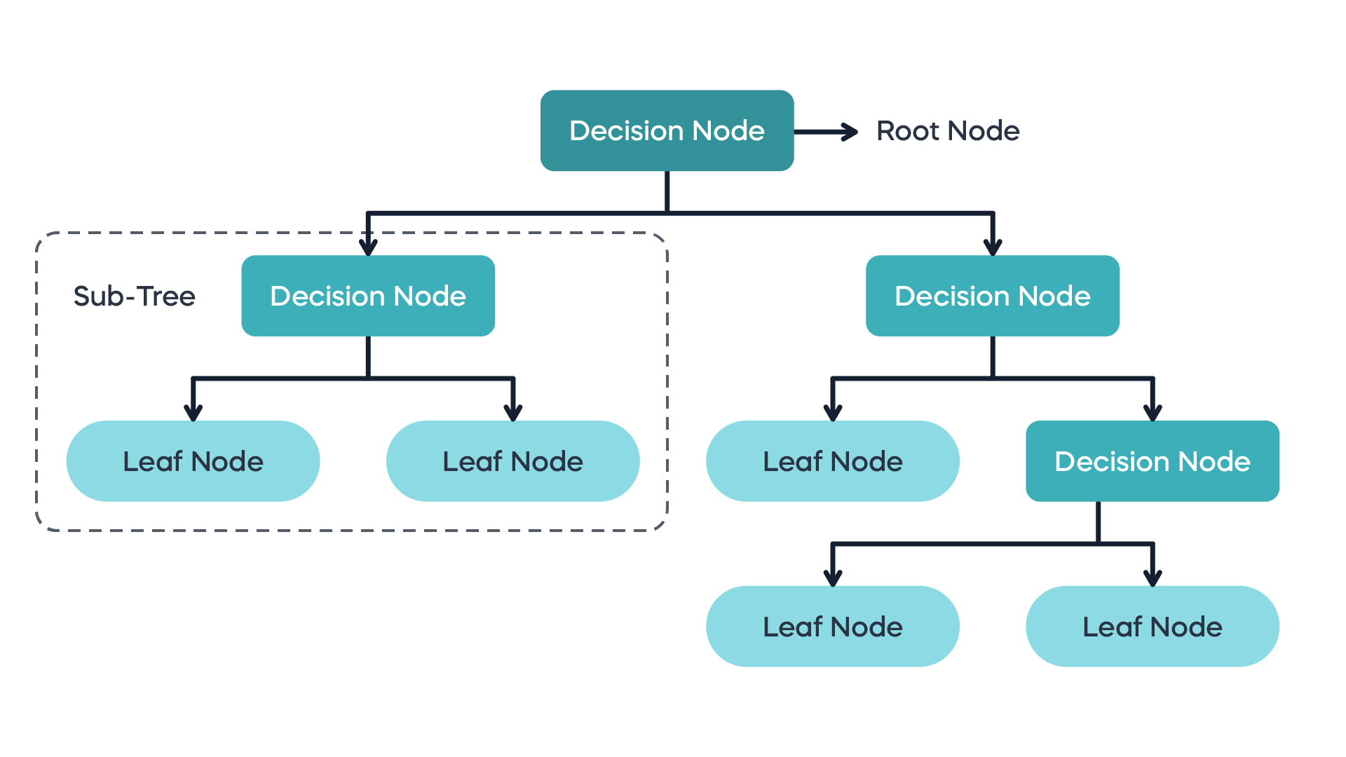
Dealing with Bias and Ensuring Data Quality
Identify Data Issues: Recognize potential biases and data quality problems early.
Direct Measurement: Prioritize directly measured information over inferred data.
Data Relevance: Ensure collected data directly addresses the problem.
Generated on AIDOCMAKER.COM (Image Credit)

Slide 19
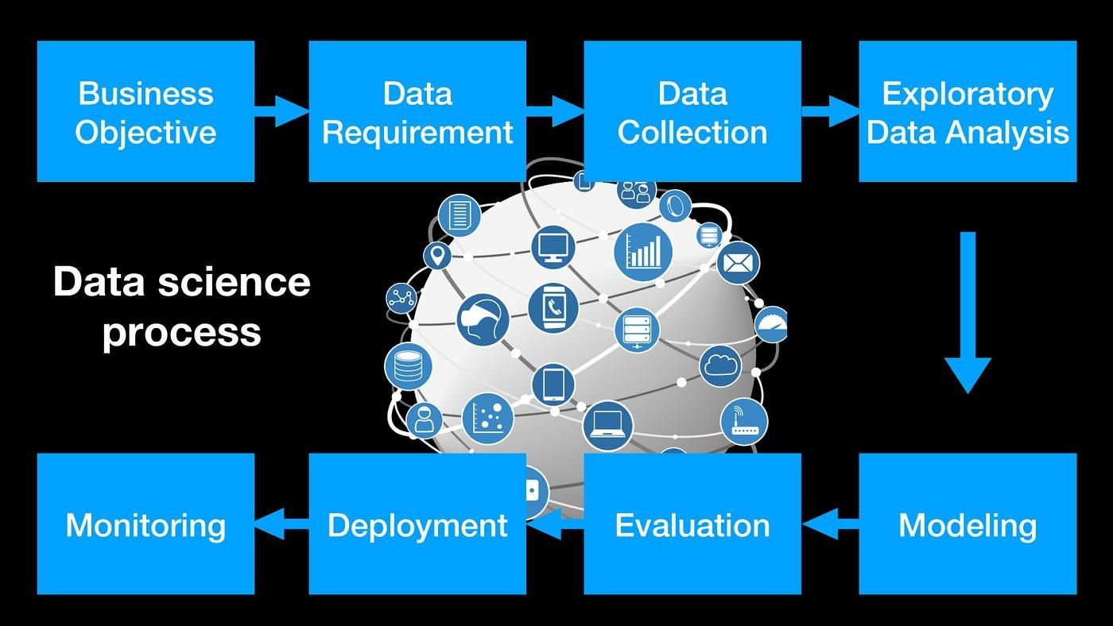
Stage 3: Data Cleaning and Exploration
Data Preparation: Repair errors and transform variables for analysis.
Exploratory Data Analysis (EDA): Visualize and explore data to find patterns and issues.
Refine Goals: Discoveries may lead to revisiting or refining project goals.
Generated on AIDOCMAKER.COM (Image Credit)

Slide 20
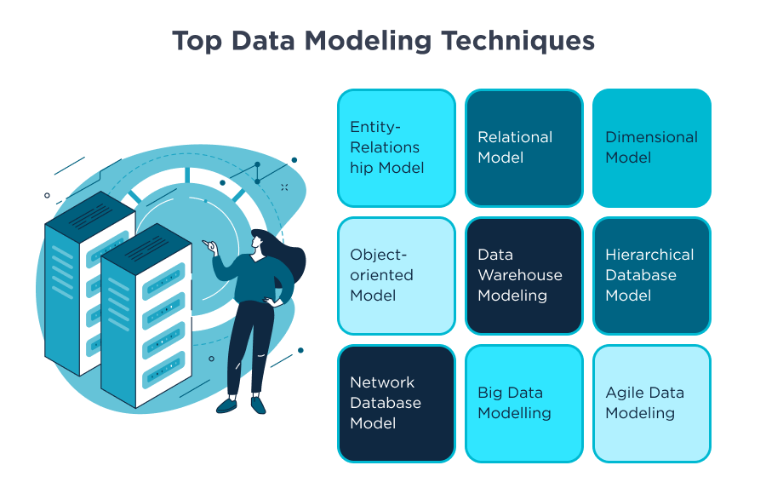
Stage 4: Modeling Techniques
Extract Insights: Apply statistical and machine learning techniques to find insights.
Common Tasks: Includes classification, scoring, ranking, clustering, and finding relations.
Choose Appropriate Methods: Select techniques based on the problem and data characteristics.
Generated on AIDOCMAKER.COM (Image Credit)

Slide 21
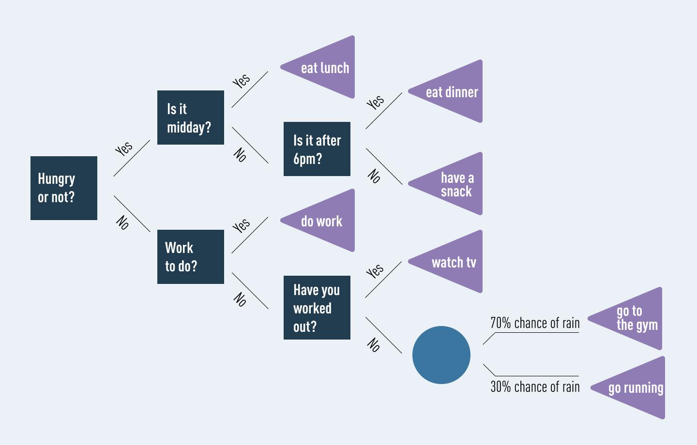
Decision Tree Example Walkthrough
Classification Task: Predicting loan default based on applicant features.
Tree Structure: Splits data based on conditions like loan duration and credit amount.
Outcome Interpretation: Leaves indicate predicted loan status and confidence scores.
Generated on AIDOCMAKER.COM (Image Credit)

Slide 22
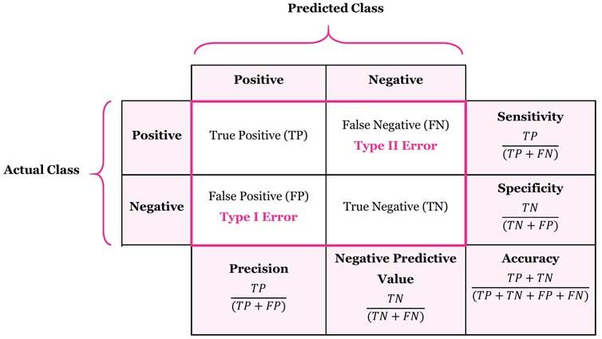
Stage 5: Model Evaluation – Metrics and Confusion Matrix
Assess Model Performance: Determine if the model meets the defined goals and accuracy requirements.
Confusion Matrix: Tabulates actual vs. predicted classifications (TP, FP, TN, FN).
Key Metrics: Evaluate accuracy, precision, recall, and false positive rate.
Generated on AIDOCMAKER.COM (Image Credit)

Slide 23

Stage 6: Presenting Results to Stakeholders
Audience-Specific Communication: Tailor presentation to business or technical audiences.
Highlight Business Impact: Focus on how findings translate to business metrics and value.
Clear Visualizations: Use charts and graphs to convey insights effectively.
Generated on AIDOCMAKER.COM (Image Credit)

Slide 24
Stage 7: Deployment and Real-World Testing
Operationalize the Model: Integrate the model into existing systems or workflows.
Pilot Programs: Often deployed initially in a small-scale pilot for testing.
Monitoring and Maintenance: Ensure smooth operation and update as needed.

Slide 25
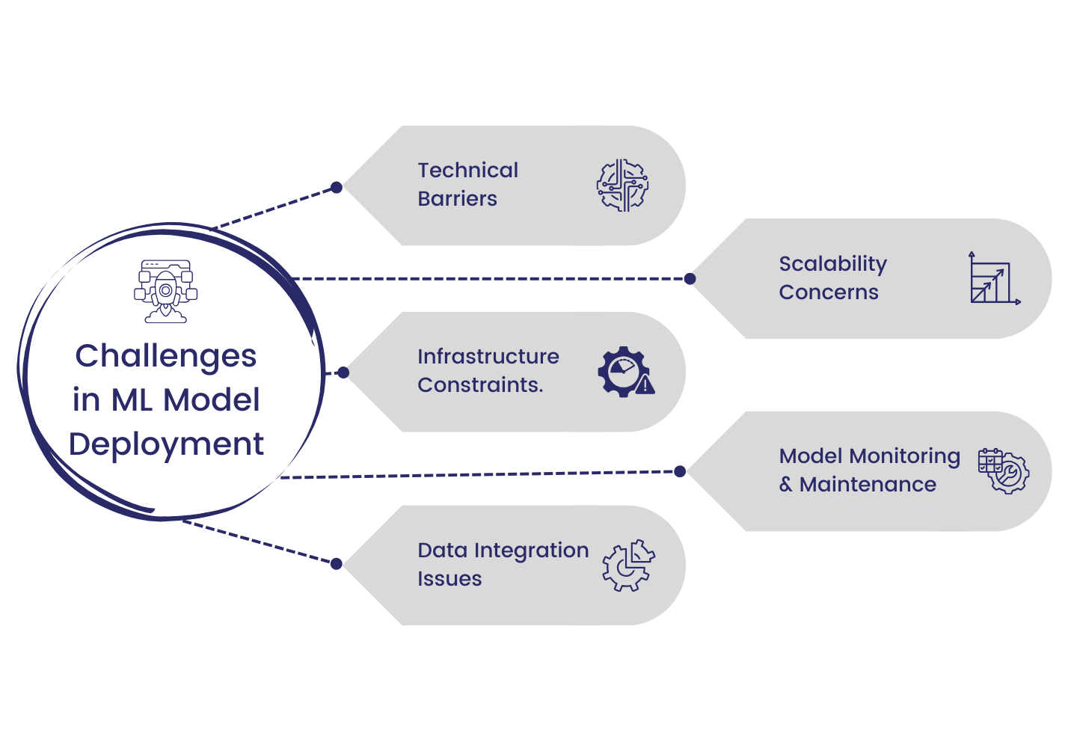
Challenges During Deployment
Environment Compatibility: Ensuring the model works across different technical environments.
User Adoption: Addressing potential user overrides or resistance to the model.
Model Decay: Managing performance degradation over time and retraining needs.
Generated on AIDOCMAKER.COM (Image Credit)

Slide 26
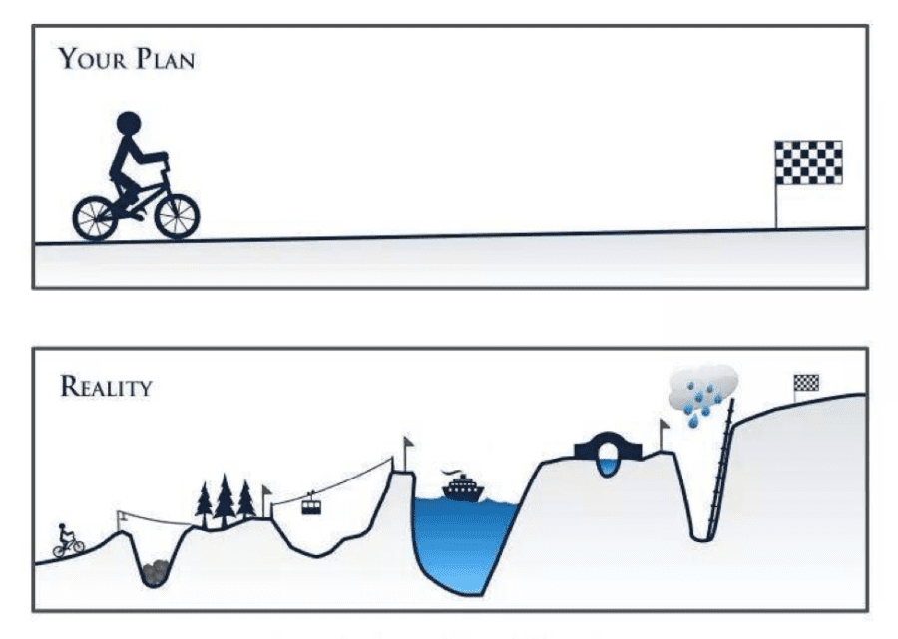
Setting Expectations and Defining Success
Manage Stakeholder Expectations: Communicate realistic performance goals and limitations.
Define Success Criteria: Establish clear benchmarks for project success upfront.
Validate Assumptions: Confirm data quality and model feasibility early on.
Generated on AIDOCMAKER.COM (Image Credit)

Slide 27
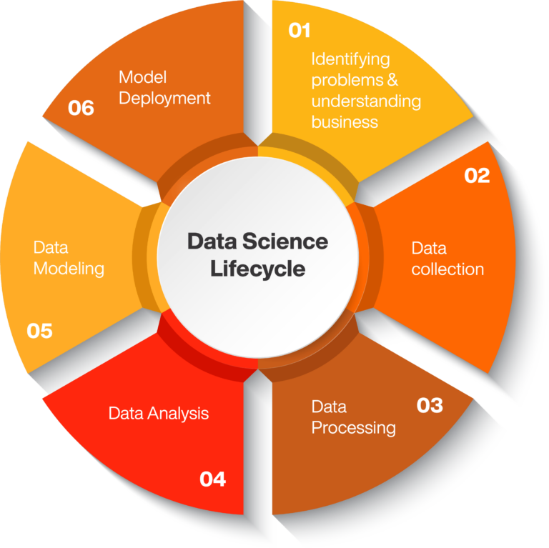
Summary of the Data Science Lifecycle
Structured Process: A systematic approach from goal definition to deployment.
Iterative Nature: Emphasizes flexibility and continuous refinement.
Key Roles and Stages: Success depends on clear roles, defined stages, and stakeholder collaboration.
Generated on AIDOCMAKER.COM (Image Credit)

